Slide 1
Interreg IPA
Romania-Serbia Programme
Cooperation beyond borders!
Programme co-funded by the European Union

Slide 2
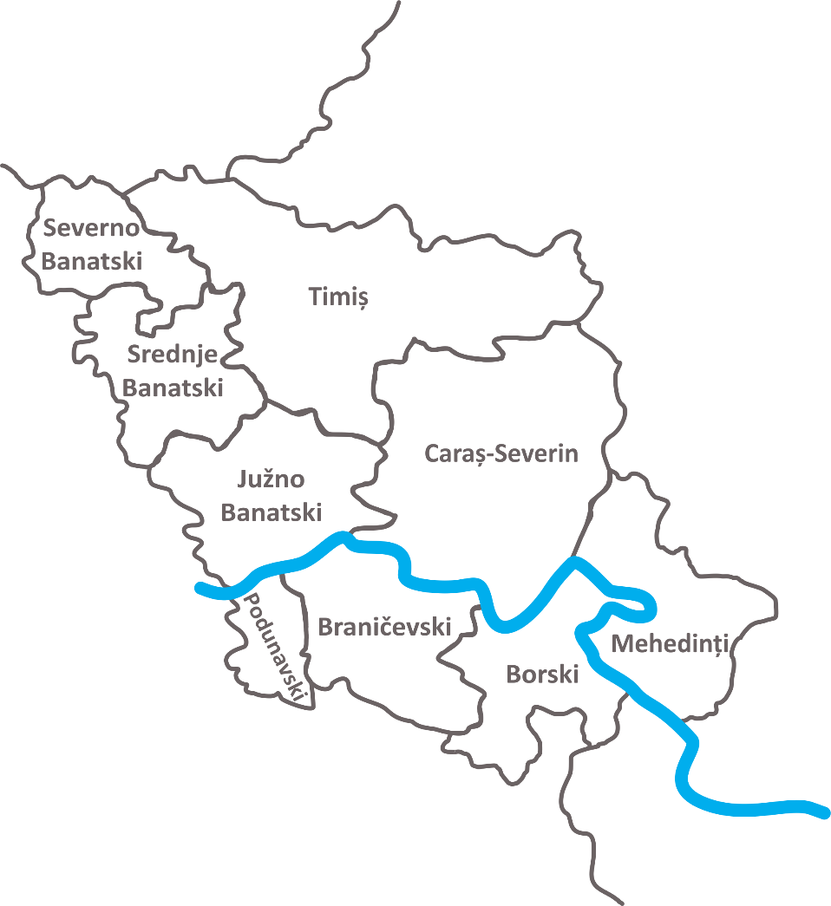
Programme area:
Romania – 3 counties:
Timiş
Caraş-Severin
Mehedinţi
Republic of Serbia – 6 districts:
Severnobanatski
Srednjebanatski
Južnobanatski
Podunavski
Braničevski
Borski

Slide 3
Call for proposals financial allocation
Priority | Union support (Euro) | Total funding (Euro) | Co-financing rate
P1: Environmental protection and risk management | 11,194,696 | 13,170,231 | 85.00%
P2: Social and economic development | 15,142,730 | 17,814,977 | 85.00%
The total amount allocated to this call for proposals is:
26,337,426 Euro (IPA funds)

Slide 4
Eligibility of actions (operations)

Slide 5
General rules:
Activities have to be carried out in the area of the Programme and must have a cross-border impact on the Programme area.
As an exception, a part of an operation may be implemented outside the Programme area but within the territory of the countries participating in the Programme.
All projects must be in line with the priorities and specific objectives.
All operations have to fall within the scope of the type of actions defined in the Programme.

Slide 6
Priority 1 – ENVIRONMENTAL PROTECTION AND RISK MANAGEMENT
Specific objective 1.1: Enhancing protection and preservation of nature, biodiversity, and green infrastructure, including in urban areas, and reducing all forms of pollution

Slide 7
SO 1.1: Enhancing protection and preservation of nature, biodiversity, and green infrastructure, including in urban areas, and reducing all forms of pollution
Types of actions:
Investments in the field of natural resources, ecosystems, and biodiversity, including technologies for environmental protection
Investments in the protection of landscapes and implementation of measures to conserve and restore ecosystems, biodiversity, forestry, and protect wildlife
Development and implementation of conservation and protection measures of Natura 2000 sites on the Romanian side and equivalent natural protected areas on the Serbian side
Implementation of measures for reducing pollution and raising awareness (e.g. waste prevention, collection, and treatment, sorting, and 5R measures)
P 1
SO 1.1
SO 1.2
SO 1.3
P 2
SO 2.1
SO 2.2
SO 1.4
SO 2.3
Notes:
Clearly described in the applicant’s guide

Slide 8
SO 1.1: Enhancing protection and preservation of nature, biodiversity, and green infrastructure, including in urban areas, and reducing all forms of pollution
Types of actions:
Investments in activities dedicated to the rehabilitation of industrial sites and contaminated land, support to the closure and rehabilitation of substandard and illegal landfill sites
Investments in measures improving air quality, air quality monitoring (e.g.: air quality monitoring networks), and noise reduction measures
Investments in green infrastructure mainly in urban areas (e.g. storm-water management, sustainable urban drainage systems (SUSDS), green streets, green roofs, permeable/porous paving, urban forests, natural cooling of buildings, subsurface detention, cisterns and rain barrels and blue and/or green infrastructure)
P 1
SO 1.1
SO 1.2
SO 1.3
P 2
SO 2.1
SO 2.2
SO 1.4
SO 2.3
Notes:
Clearly described in the applicant’s guide

Slide 9
SO 1.1: Enhancing protection and preservation of nature, biodiversity, and green infrastructure, including in urban areas, and reducing all forms of pollution
Types of actions:
Expanding green infrastructure that connects habitats, strengthens ecological corridors and protected sites, reducing landscape fragmentation and ensuring their recreational potential
Joint strategies and action plans tackling the issue of pollution, nature protection, and biodiversity protection
Testing of new tools, instruments, experiments, transfer of solutions between relevant stakeholders, and increasing the cross-border cooperation in the field of biodiversity, nature protection, green infrastructure, and reducing pollution
Investments in activities dedicated to the control of pollution and rehabilitation of rivers and brownfields
P 1
SO 1.1
SO 1.2
SO 1.3
P 2
SO 2.1
SO 2.2
SO 1.4
SO 2.3
Notes:
Clearly described in the applicant’s guide

Slide 10
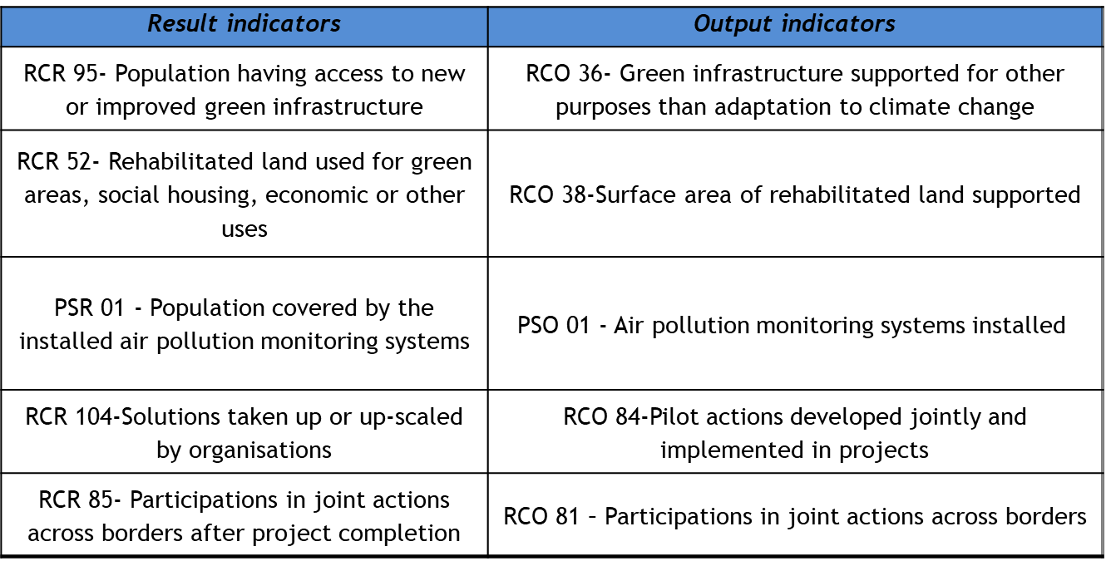
SO 1.1: Enhancing protection and preservation of nature, biodiversity, and green infrastructure, including in urban areas, and reducing all forms of pollution
Indicators:
P 1
SO 1.1
SO 1.2
SO 1.3
P 2
SO 2.1
SO 2.2
SO 1.4
SO 2.3

Slide 11
SO 1.1: Enhancing protection and preservation of nature, biodiversity, and green infrastructure, including in urban areas, and reducing all forms of pollution
Further details:
Project duration: 9 – 24 months (from the starting date of the project)
Project budget: 250,000 – 2,000,000 EURO (IPA funds requested for one project)
The eligibility of an action does not confer eligibility on the expenditure made for the implementation of that activity
P 1
SO 1.1
SO 1.2
SO 1.3
P 2
SO 2.1
SO 2.2
SO 1.4
SO 2.3

Slide 12
Priority 1 – ENVIRONMENTAL PROTECTION AND RISK MANAGEMENT
Specific objective 1.2: Promoting renewable energy in accordance with Directive (EU) 2018/2001, including the sustainability criteria set out therein

Slide 13
SO 1.2: Promoting renewable energy in accordance with Directive (EU) 2018/2001, including the sustainability criteria set out therein
Types of actions:
Solutions developed through joint “pilot actions” in renewable energy (e.g. wind, solar, geothermal).
P 1
SO 1.1
SO 1.2
SO 1.3
P 2
SO 2.1
SO 2.2
SO 1.4
SO 2.3

Slide 14
SO 1.2: Promoting renewable energy in accordance with Directive (EU) 2018/2001, including the sustainability criteria set out therein
Indicators:
P 1
SO 1.1
SO 1.2
SO 1.3
P 2
SO 2.1
SO 2.2
SO 1.4
SO 2.3

Slide 15
SO 1.2: Promoting renewable energy in accordance with Directive (EU) 2018/2001, including the sustainability criteria set out therein
Further details:
Project duration: 9 – 24 months (from the starting date of the project)
Project budget: 250,000 – 2,000,000 EURO (IPA funds requested for one project)
The eligibility of an action does not confer eligibility on the expenditure made for the implementation of that activity
P 1
SO 1.1
SO 1.2
SO 1.3
P 2
SO 2.1
SO 2.2
SO 1.4

Slide 16
Priority 1 – ENVIRONMENTAL PROTECTION AND RISK MANAGEMENT
Specific objective 1.3: Promoting energy efficiency and reducing green-house gas emissions

Slide 17
SO 1.3: Promoting energy efficiency and reducing green-house gas emissions
Types of actions:
Investments in energy efficiency measures regarding public infrastructure;
Promotion of energy efficiency and resource efficiency measures;
Demonstration projects and initiatives for reducing emissions of greenhouse gas and air pollutants;
Investment in supporting measures for reducing emissions of greenhouse gas and air pollutants.
P 1
SO 1.1
SO 1.2
SO 1.3
P 2
SO 2.1
SO 2.2
SO 1.4
SO 2.3

Slide 18
SO 1.3: Promoting energy efficiency and reducing green-house gas emissions
Indicators:
P 1
SO 1.1
SO 1.2
SO 1.3
P 2
SO 2.1
SO 2.2
SO 1.4
SO 2.3

Slide 19
SO 1.3: Promoting energy efficiency and reducing green-house gas emissions
Further details:
Project duration: 9 – 18 months (from the starting date of the project)
Project budget: 250,000 – 2,000,000 EURO (IPA funds requested for one project)
The eligibility of an action does not confer eligibility on the expenditure made for the implementation of that activity
P 1
SO 1.1
SO 1.2
SO 1.3
P 2
SO 2.1
SO 2.2
SO 1.4
SO 2.3

Slide 20
Priority 1 – ENVIRONMENTAL PROTECTION AND RISK MANAGEMENT
Specific objective 1.4: Promoting climate change adaptation and disaster risk prevention and resilience, taking into account ecosystem-based approaches

Slide 21
SO 1.4: Promoting climate change adaptation and disaster risk prevention and resilience, taking into account ecosystem-based approaches
Types of actions:
Restoration of natural areas (e.g. forests, river banks) to prevent floods and land slides
Development and implementation of measures such as restoration of Natura 2000 sites on the Romanian side and equivalent natural protected areas on the Serbian side, in relation to climate change impact
Afforestation and reforestation (e.g. protection forests) of the areas vulnerable to floods and landslides
P 1
SO 1.1
SO 1.2
SO 1.3
P 2
SO 2.1
SO 2.2
SO 1.4
SO 2.3

Slide 22
SO 1.4: Promoting climate change adaptation and disaster risk prevention and resilience, taking into account ecosystem-based approaches
Types of actions:
Development and implementation of measures and ecosystem-based approaches related to adaptation to climate change;
Development and implementation of measures in relation to climate change mitigation solutions;
Measures related to the prevention and management of climate-related risks, like fires, storms, and drought;
P 1
SO 1.1
SO 1.2
SO 1.3
P 2
SO 2.1
SO 2.2
SO 1.4
SO 2.3

Slide 23
SO 1.4: Promoting climate change adaptation and disaster risk prevention and resilience, taking into account ecosystem-based approaches
Types of actions:
Risk prevention and management of non-climate related natural risks (i.e. earthquakes) and risks linked to human activities (e.g. technological accidents), civil protection and disaster management systems, and infrastructures;
Development and implementation of awareness measures and training products in the field of environment and emergency preparedness, including for children/ youth to respond to emergency situations;
P 1
SO 1.1
SO 1.2
SO 1.3
P 2
SO 2.1
SO 2.2
SO 1.4
SO 2.3

Slide 24
SO 1.4: Promoting climate change adaptation and disaster risk prevention and resilience, taking into account ecosystem-based approaches
Types of actions:
Implementing joint works for flood prevention on the Danube River, its tributary rivers, and the Danube basin, preferably with nature-based solutions;
Joint strategies and action plans for preventing natural risks and for enhancing climate change adaptation;
Development and implementation of awareness measures in the field of climate change;
P 1
SO 1.1
SO 1.2
SO 1.3
P 2
SO 2.1
SO 2.2
SO 1.4
SO 2.3

Slide 25
SO 1.4: Promoting climate change adaptation and disaster risk prevention and resilience, taking into account ecosystem-based approaches
Indicators:
P 1
SO 1.1
SO 1.2
SO 1.3
P 2
SO 2.1
SO 2.2
SO 1.4
SO 2.3

Slide 26
SO 1.3: Promoting energy efficiency and reducing green-house gas emissions
Further details:
Project duration: 9 – 24 months (from the starting date of the project)
Project budget: 250,000 – 2,000,000 EURO (IPA funds requested for one project)
The eligibility of an action does not confer eligibility on the expenditure made for the implementation of that activity
P 1
SO 1.1
SO 1.2
SO 1.3
P 2
SO 2.1
SO 2.2
SO 1.4
SO 2.3

Slide 27
Priority 2 – SOCIAL AND ECONOMIC DEVELOPMENT
Specific objective 2.1: Improving equal access to inclusive and quality services in education, training, and life-long learning through developing accessible infrastructure, including by fostering resilience for distance and online education and training

Slide 28
SO 2.1: Improving equal access to inclusive and quality services in education, training and life-long learning through developing accessible infrastructure, including by fostering resilience for distance and on-line education and training
Types of actions:
Elaboration of working procedures, joint platforms, and joint events for online education and training;
Measures for developing highly technical skills and competences;
Joint measures for improving the link between the labour market and the education and training system;
Exchange of best practices or guidelines in the field of improving access to and the quality of education, training, and lifelong learning across borders;
Development and implementation of joint actions to support the adaptation of youth to market needs (e.g. digital skills);
P 1
SO 1.1
SO 1.2
SO 1.3
P 2
SO 2.1
SO 2.2
SO 1.4
SO 2.3

Slide 29
SO 2.1: Improving equal access to inclusive and quality services in education, training and life-long learning through developing accessible infrastructure, including by fostering resilience for distance and on-line education and training
Types of actions:
Development and implementation of measures to ensure social inclusion and social innovation, as well as support for green and digital re-skilling and up-skilling
Development and implementation of measures to support the creation of resilient and sustainable jobs and the employment of people with the vulnerable background
Investments in the endowment of educational and training facilities
Investments in joint IT solutions that will facilitate online education and training
Investments in infrastructure and services for training, including technical and vocational, and life-long learning
P 1
SO 1.1
SO 1.2
SO 1.3
P 2
SO 2.1
SO 2.2
SO 1.4
SO 2.3

Slide 30
SO 2.1: Improving equal access to inclusive and quality services in education, training, and life-long learning through developing accessible infrastructure, including by fostering resilience for distance and on-line education and training
Indicators:
P 1
SO 1.1
SO 1.2
SO 1.3
P 2
SO 2.1
SO 2.2
SO 1.4
SO 2.3

Slide 31
SO 2.1: Improving equal access to inclusive and quality services in education, training, and life-long learning through developing accessible infrastructure, including by fostering resilience for distance and online education and training
Further details:
Project duration: 9 – 24 months (from the starting date of the project)
Project budget: 250,000 – 2,000,000 EURO (IPA funds requested for one project)
The eligibility of an action does not confer eligibility on the expenditure made for the implementation of that activity
P 1
SO 1.1
SO 1.2
SO 1.3
P 2
SO 2.1
SO 2.2
SO 1.4
SO 2.3

Slide 32
Priority 2 – SOCIAL AND ECONOMIC DEVELOPMENT
Specific objective 2.2: Ensuring equal access to health care and fostering resilience of health systems, including primary care, and promoting the transition from institutional to family-based and community-based care

Slide 33
2.2: Ensuring equal access to health care and fostering resilience of health systems, including primary care, and promoting the transition from institutional to family-based and community-based care
Types of actions:
Development and implementation of actions to support digitalization in healthcare and health mobile assets
Development and implementation of measures to improve accessibility effectiveness and resilience of healthcare systems and long-term care services across borders
Investments in building/renovation/endowment of healthcare facilities (including laboratories)
Purchase of high-tech equipment for supporting telemedicine services
P 1
SO 1.1
SO 1.2
SO 1.3
P 2
SO 2.1
SO 2.2
SO 1.4
SO 2.3

Slide 34
2.2: Ensuring equal access to health care and fostering resilience of health systems, including primary care, and promoting the transition from institutional to family-based and community-based care
Types of actions:
Investments in improving healthcare and long-term care services for the elderly, through home care and community-based care services
Elaboration of joint working procedures, joint platforms, and joint strategies for tackling cross-border medical threats
Know-how exchange and capacity-building activities (joint training, conferences, workshops)
P 1
SO 1.1
SO 1.2
SO 1.3
P 2
SO 2.1
SO 2.2
SO 1.4
SO 2.3

Slide 35
2.2: Ensuring equal access to health care and fostering resilience of health systems, including primary care, and promoting the transition from institutional to family-based and community-based care
Indicators:
P 1
SO 1.1
SO 1.2
SO 1.3
P 2
SO 2.1
SO 2.2
SO 1.4
SO 2.3

Slide 36
2.2: Ensuring equal access to health care and fostering resilience of health systems, including primary care, and promoting the transition from institutional to family-based and community-based care
Further details:
Project duration: 9 – 24 months (from the starting date of the project)
Project budget: 250,000 – 2,000,000 EURO (IPA funds requested for one project)
The eligibility of an action does not confer eligibility on the expenditure made for the implementation of that activity
P 1
SO 1.1
SO 1.2
SO 1.3
P 2
SO 2.1
SO 2.2
SO 1.4
SO 2.3

Slide 37
Priority 2 – SOCIAL AND ECONOMIC DEVELOPMENT
Specific objective 2.3: Enhancing the role of culture and sustainable tourism in economic development, social inclusion, and social innovation

Slide 38
2.3: Enhancing the role of culture and sustainable tourism in economic development, social inclusion, and social innovation
Types of actions:
Development and implementation of measures to develop and promote sustainable tourism assets and services, ensuring social inclusion and social innovation
Development and implementation of measures to protect, develop and promote natural heritage and eco-tourism, health tourism, business tourism, sport/cyclo/hiking tourism
Development and implementation of measures to protect, develop and promote cultural heritage and cultural services
P 1
SO 1.1
SO 1.2
SO 1.3
P 2
SO 2.1
SO 2.2
SO 2.3
SO 1.4

Slide 39
2.3: Enhancing the role of culture and sustainable tourism in economic development, social inclusion, and social innovation
Types of actions:
Investments in physical regeneration of cultural and touristic objectives, in the scope of their inclusion in the touristic and/ or cultural circuit;
Joint actions in the field of development of sustainable touristic and cultural services.
P 1
SO 1.1
SO 1.2
SO 1.3
P 2
SO 2.1
SO 2.2
SO 2.3
SO 1.4

Slide 40
2.3: Enhancing the role of culture and sustainable tourism in economic development, social inclusion, and social innovation
Indicators:
P 1
SO 1.1
SO 1.2
SO 1.3
P 2
SO 2.1
SO 2.2
SO 2.3
SO 1.4

Slide 41
2.3: Enhancing the role of culture and sustainable tourism in economic development, social inclusion, and social innovation
Further details:
Project duration: 9 – 24 months (from the starting date of the project)
Project budget: 250,000 – 2,000,000 EURO (IPA funds requested for one project)
The eligibility of an action does not confer eligibility on the expenditure made for the implementation of that activity
P 1
SO 1.1
SO 1.2
SO 1.3
P 2
SO 2.1
SO 2.2
SO 2.3
SO 1.4

Slide 42
Project application
The application process shall be done through the Programme’s Electronic Monitoring System (JEMS).
Deadline for submission: 01.02.2023 16:00, Romanian local time
The Programme’s Electronic Monitoring System is accessible at the following web address:
https://jems-rors.mdlpa.ro
Helpdesk:
E-mail: helpdesk@brct-timisoara.ro
Telephone: +40 356 42 63 60
Fax: +40 356 42 63 61

